Slide 1
Unit-4 Network Planning and Deployment
21ECE324T-ADVANCED MOBILE COMMUNICATION SYSTEMS

Slide 2
Syllabus
Core and Transmission Network Dimensioning
Radio Network Planning
Core and Radio Network Deployment Scenarios
Standalone and Non-Standalone Deployment Scenarios
Network Interfaces and Elements
Core deployment
Measurements

Slide 3
Introduction to 5G Network Planning
Why network planning is critical for 5G
Key differences from 4G planning
Planning considerations: capacity, coverage, latency

Slide 4
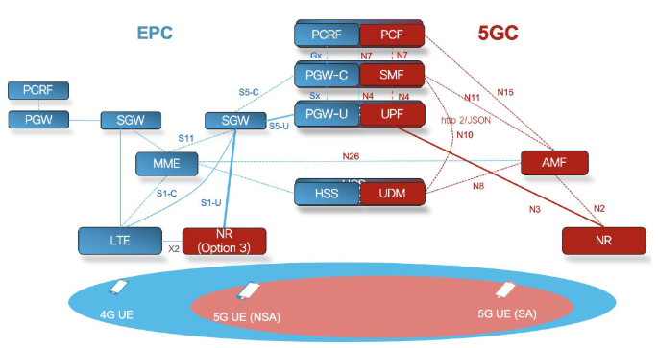
4G VS 5G

Slide 5
Core Network Dimensioning
The main elements in the optimal network planning are related to the capacity, coverage, and quality of service (QoS)
Optimal network design balances costs to ensure a return on investment.
It must avoid being too expensive, which wastes capacity, and too low-cost, which can lead to reduced quality and increased customer churn.

Slide 6
1) Capacity Estimation
5G Networks and IoT Devices: 5G must support a large number of IoT devices communicating simultaneously.
Diverse Traffic Types: 5G handles diverse traffic types, including eMBB, critical communications, and massive IoT.
Network Slicing: Network slicing manages different traffic types individually to optimize capacity.
Slicing Benefits: Slices include only necessary network functions, optimizing resource use.

Slide 7
1) Capacity Estimation
Traffic Peaks Preparation: Preparing for unexpected traffic peaks is essential for reliable service.
NFV and SDN: Network Functions Virtualization (NFV) and Software-Defined Networking (SDN) enhance scalability and flexibility.
Cost Optimization: NFV and SDN help optimize costs by reducing hardware dependency and enabling fast service updates.
Deployment Strategy: Initial deployments often leverage existing 4G infrastructure for efficiency.
Optimization Techniques: SDN and NFV optimize resource allocation and reduce latency by strategically placing VNFs.

Slide 8
2 Transport
The dimensioning of transport network infrastructure is one of the important tasks of a 5G operator.
The deployment models for the 5G transport network are highly needed to understand the respective capacity requirements and to assess the suitability of current networking technologies.
5G-XHaul is a European-wide project defining converged fronthaul (FH) and backhaul (BH) networks for future 5G mobile networks. It defines a logical transport architecture integrating multiple wireless and optical technologies under a common SDN control plane.

Slide 9
Xhaul Architecture
5G-XHaul Project: A European initiative for converged fronthaul and backhaul networks in 5G mobile systems.
Unified SDN Control Plane: Integrates multiple wireless and optical technologies under a common SDN control plane.
Flexible RAN Functional Splits: Supports flexible splits in the Radio Access Network (RAN).
Partnerships: Involves partners like Huawei, Telefónica, and various universities.
SDN Control Plane Features: Aware of spatiotemporal demand variations in the RAN and interfaces with both wireless and optical networks.
Data Plane Unification: Unifies the transport of various wireless networks, including mm-Wave (60 GHz), Sub-6 GHz, optical, TSON, and WDM-PON.

Slide 10
Effect of Network Slicing
Network slicing divides a physical network into multiple virtual networks for specific use cases. It allows customization for different applications with varying bandwidth, latency, and security requirements.
Network slicing supports diverse use cases like IoT, smart homes, and industrial automation. It relies on network virtualization technologies such as SDN and NFV.
Network slicing enables efficient resource allocation and faster service deployment.
IoT services benefit from dynamic slices with enhanced control and user planes. Different slices can be optimized for security or reliability based on the use case.
Mobile Network Operators must dimension slices according to specific use case requirements.
Optimization tasks include reducing control plane signaling and maximizing user plane resource utilization.
Network slicing is crucial for providing tailored network configurations for various services.

Slide 11
5G Radio Network Planning
Radio Channel Modeling
Radio channel modeling is crucial for planning 5G radio coverage and capacity.
Various models are used due to differences in geographical topologies globally and within countries.
Models like ray-tracing with 3D map data are used in dense urban areas, while simpler models suffice for rural areas.
The choice of model depends on balancing accuracy with cost, especially for detailed map data.
Established models for previous mobile generations need revision for 5G's higher frequency bands and wider bandwidths.

Slide 12
5G Radio Network Planning
Radio Channel Modeling
Research projects by 3GPP, ITU-R, METIS, and others are investigating suitable models for 5G.
The number of 5G RF bands is expected to be higher, including multiple mm-Wave bands, requiring updated models.
Massive MIMO and hybrid beamforming are key technologies in 5G for achieving high data speeds in dense areas.
MIMO arrays often use fewer RF chains than antenna elements, with subarrays forming predefined beam shapes.
Resources like 3GPP TR 25.996 provide insights into MIMO radio dimensioning for different cell topologies.

Slide 13
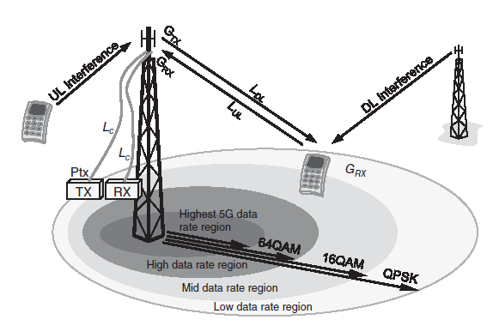
5G Radio Link Budget Considerations

Slide 14
Maximum Allowable Path Loss (MAPL):
This is the maximum path loss that can occur between the transmitter and receiver while still maintaining an acceptable quality of service (QoS). It is used to determine the cell radius or coverage area.
Link Budget Equation:
Received Power (Prx)=Transmit Power (Pt)+Transmitter Antenna Gain (Gt)−Propagation Loss (Lp)+Receiver Antenna Gain (Gr)
This equation calculates the received signal level at the receiver, which is compared to the receiver sensitivity to determine if the channel status is pass or fail.

Slide 15



Friis Equation
For Gt, Gr, Pt as unity
For convenience, this formula is often rewritten in terms of frequency (fc) instead of wavelength:

Slide 16


Path Loss Formula: For example, using the UMa model for Line Of Sight (LOS) cases:
d is the distance between the transmitter and receiver
fc is the carrier frequency.
Cell Radius Calculation:
This formula calculates the cell radius based on the path loss value.

Slide 17


Coverage Area Calculation:
the area covered by a single base station, where R is the cell radius.
Required Number of Base Stations:
This formula determines how many base stations are needed to cover a given area.

Slide 18
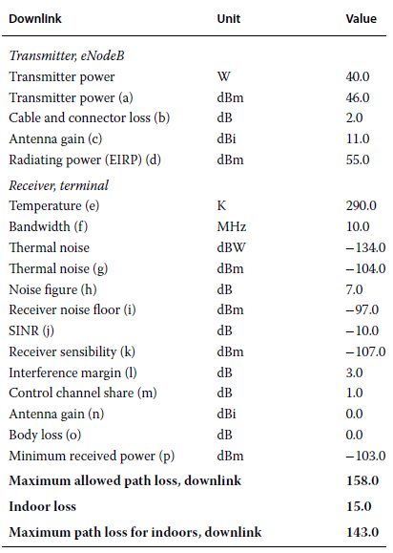
The principle of the downlink radio link budget

Slide 19
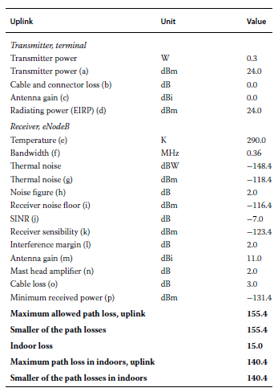
The principle of the uplink radio link budget.

Slide 20
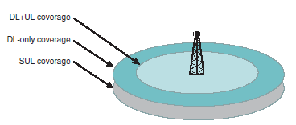
The principle of SUL (supplementary uplink).

Slide 21
5G Radio Link Budgeted in Bands above 6 GHz
The frequency bands above 6 GHz for small cells are introduced to 5G as a novelty solution. These bands are included in the band set to facilitate the scalability, capacity, and density that 5G requires in the efforts to integrate the expected considerable number of small cells into the rest of the cellular network infrastructure.
The reference introduces key system parameters:
Carrier frequency: 28 GHz
Transmitter’s Effective Isotropic Radiated Power (EIRP) and receiver’s antenna gain: 65 dBm
Bandwidth: 1 GHz
Receiver’s noise figure: 7 dB
Miscellaneous losses: 10 dB
Target data rate: 1 or 0.1Gb/s
Target signal-to-noise ratio (SNR): 0 or −11.4 dB

Slide 22
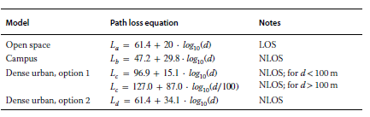

28 GHz
39 GHz

Slide 23


60 GHz
72 GHz

Slide 24
Core and Radio Network Deployment Scenarios
The 5G system (5GS) has raised a big interest in the telecommunications industry, and it can be expected that the markets will be deploying early-stage 5G well before the actual ITU-R IMT-2020 candidate technologies have been presented and formally approved.

Slide 25
Trials and Early Adopters Prior to 2020
VerizonWireless
The focus of these trials has been on a subset of New Radio (NR), such as Fixed Wireless Access without mobility support. During this time, the user devices have been limited to Consumer Premise Equipment, such as set-top boxes.
The Verizon 5GTF has been in elemental role for the 5G trialing. It has been a cooperative setup with Cisco, Ericsson, Intel, LG, Nokia, Qualcomm, and Samsung participating in the efforts.
The idea has been to define a common and extendable platform for the 28 and 39 GHz fixed wireless access trials and deployments

Slide 26
AT&T
The focus of this activity has been on fixed wireless 5G trials, including business and residential customers in Waco, Texas; Kalamazoo, Michigan; and South Bend, Indiana, by the end of 2017.
The applied use cases included car wash and other small businesses, apartment test sites, etc. The results have demonstrated experimented data speeds up to 1Gb/s and latency rates well under 10ms for the radio link.
The setup has been utilized to conduct further outdoor pre-standards mobile 5G testing.
DoCoMo
Telia Company
European Union

Slide 27
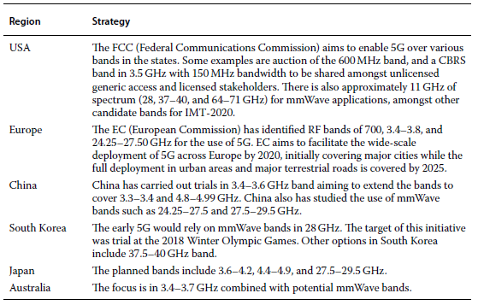
5G Frequency Bands

Slide 28
Core and Radio Network Deployment Scenarios
The 3GPP TR38.801 presents practical deployment scenarios for the 5G architecture. These scenarios are:
Non-centralized
Co-sited with E-UTRA
Centralized
Shared radio access network (RAN)
Heterogenous deployment
As an alternative point of view, the high-level scenarios can be categorized into two cases: non-standalone (NSA) and standalone deployments,

Slide 29
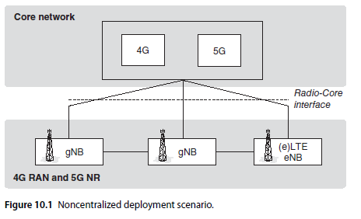
Non-centralized
The non-centralized deployment scenario refers to a set of 5G NodeB (gNB) elements equipped with a full protocol stack. The scenario is suitable especially in macro cell and indoor hotspot deployments. The gNB elements can connect with other gNB elements or LTE eNB and eLTE eNB elements. The eLTE eNB is the evolved version of eNB that supports connectivity to both 4G enhanced-packet core (EPC) and 5G Next Generation Core (NGC).

Slide 30
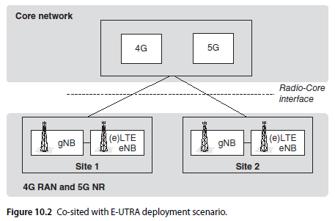
Co-sited with E-UTRA
In co-sited deployment scenario, the 5G NR functionality is co-sited with 4G E-UTRA functionality as part of the base station or as multiple base stations at the same site. This deployment scenario is suitable for any cell types, including Urban Macro. Load balancing works to optimize the spectrum resource utilization for the radio access technologies, e.g. in such a way that the lowest frequencies can be applied for ensuring the constant coverage in cell edge, while higher frequencies ensure the optimal user data rates.
Evolved UMTS Terrestrial Radio Access

Slide 31
Centralized Deployment
The 5G NR supports centralization of the upper layers of the NR radio protocols.
The performance of the transport layer between the lower layers of gNB elements and centralized element may be set differently depending on the case.
Non-co-sited and co-sited deployment scenarios with E-UTRA are applicable in this scenario. These cases include:
High-performance transport, such as optical network, and lower layers of gNB elements. This option can provide benefits for advanced coordinated multipoint (CoMP) scenarios and for optimization of scheduling, which provides high capacity.
Low-performance transport, with less-demanding performance in terms of bandwidth, delay, synchronization and jitter, and lower layers of gNB elements.
This scenario is possible as the higher protocol layers have lower performance requirements for the transport layer.

Slide 32
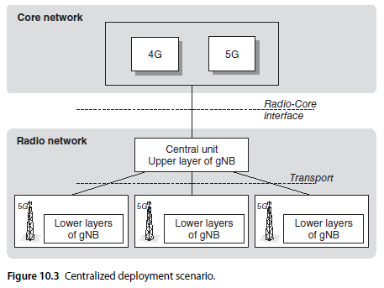
Centralized Deployment

Slide 33
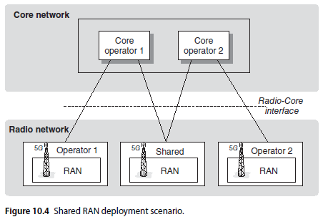
Shared RAN
The 5G NR supports shared RAN deployment scenario applicable for the cooperation between various core network operators. In addition to the shared serving areas, which can vary from localized up to national coverage, the operators can have also their individual serving areas adjacent to the shared ones.
The 5G NR supports shared RAN scenarios where various hosted core operators are present. It is also possible to deploy heterogenous RAN service areas, which can be optimal for locations such as indoor deployments in cooperation. This is due to the requirement of a fluent interworking between shared RAN and non-shared RAN

Slide 34
Heterogeneous Deployment
A heterogeneous deployment refers to a set of more than one scenarios described previously

Slide 35
Standalone and Non-Standalone Deployment Scenarios
The 5G system provides the mobile network operators (MNOs) with various deployment options to pave the way for the gradual evolvement of 5G.
The key aspect in this is the possibility to rely on the 4G infrastructure while the fully native 5G infrastructure is under construction.
The native 5G refers to standalone network architecture where the 5G NR is directly connected to the 5G core, i.e. NGC.
The non-standalone options refer to different scenarios where 4G and 5G radio access technologies, i.e. E-UTRA and NR, respectively, as well as 4G and 5G core networks cooperate.

Slide 36
As stated in 3GPP TS 23.799, the most relevant scenarios for deploying the interfaces between the radio access and core networks are the following:
Option 2: The Standalone 5G NR gNB is connected to the 5G NGC.
Option 3/3A, the LTE eNB is connected to the 4G EPC with non-standalone NR. The NR user plane (UP) is connected to the EPC via the LTE eNB (Option 3) or directly (Option 3A).
Option 4/4A, the 5G NR gNB is connected to the 5G NGC with non-standalone E-UTRA. The E-UTRA user plane is connected to the NGC via the gNB (Option 4) or directly (Option 4A).
Option 5, the eLTE eNB is connected to the NGC; Please note that this option has been deprioritized in the latest 3GPP specifications.
Option 7/7A, the eLTE eNB is connected to the NGC with non-standalone NR. The NR user plane

Slide 37
Types of Interfaces
The interfaces shown in the following sections refer to:
NG1 is designed for the control plane between the 5G UE and 5G Core.
NG2 is designed for the control plane between the 5G RAN and 5G Core.
NG3 is designed for the user plane between the 5G RAN and 5G Core.

Slide 38
Standalone 4G/5G RAN and NGC
The standalone deployment scenario refers to the 4G E-UTRAN or 5GNR and 5GNGC, which are connected directly with each other while the 4G infrastructure does not participate in the 5G communications.
In this scenario, the NG1 interface is the control plane reference point for 5G UE and 5G core. The NG2 interface is the control plane reference point for the 5G NR and 5G core while the NG3 interface is the user plane reference point for the 5G NR and 5G core.
The scenario with 4GE-UTRAN connected to the 5GNGC is similar to the 5GNR and 5G NGC, meaning that it is called standalone because there are no new requirements needed for the support of legacy EPC or E-UTRAN.
Both scenarios are depicted in Figure 10.5. This scenario with newly defined 5G NR radio access and 5G NGC is relevant when NR access systems are deployed in areas without the presence of legacy Long Term Evolution (LTE) and EPC infrastructure.

Slide 39
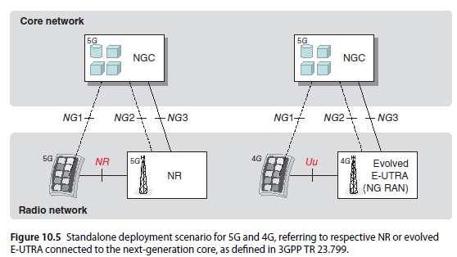
Standalone 4G/5G RAN and NGC

Slide 40
Non-Standalone 5G NR with 4G EPS
The 4G E-UTRA can be used in a dual connectivity architecture in such a way that the 4G eNB represents an anchor component carrier for user and control plane. The 5G NR access represents thus a secondary component carrier and uses solely control plane. This scenario refers to non-standalone architecture because legacy eNB and EPC network functions are needed for the deployment of the user plane of the NR access
This scenario can be divided into two parts:
Option 3 refers to the architecture that delivers the user plane traffic from the NR access via the 4G eNB, which routes it to EPC.
In Option 3a, the UP traffic can be routed directly from the 5G NR access node to the 4G EPC by relying on the S1-U interface. This scenario is depicted in Figure 10.6. It is suitable in early deployment of 5G NR when legacy eNB and EPC infrastructure is available, and the deployment can thus be based on the already existing S1-MME, S1-U, and NAS (non-access stratum) signalling interfaces.

Slide 41
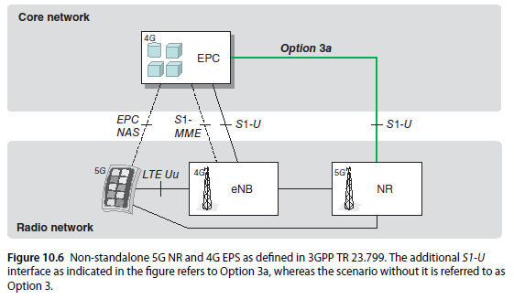
Non-Standalone 5G NR with 4G EPS

Slide 42
Non-Standalone 5G NR with 5G NGC
The non-standalone scenario with E-UTRA supporting 5G NR user plane, providing dual connectivity, can also be done based on 5G NGC instead of the legacy 4G EPC. This scenario requires legacy eNB network functions to support the new NR access for the user plane. Also, there is a need to upgrade the eNB elements to support the new NG1, NG2, and NG3 interfaces for the connectivity to the 5G NGC. This is why the upgraded 4G eNB is referred to as evolved eNB.
The base model routes the user plane traffic from the NR radio via the evolved eNB to the 5G NGC. In the alternative option referred to as 7a, traffic goes directly via the 5G NR access node to the 5G NGC. Figure 10.7 depicts this scenario. This scenario may be worth considering when 5GNR access systems are deployed in locations where already existing eNB and EPC infrastructure exists and are ready for upgrade or replacement with the evolved eNB elements and the 4G NGC, providing new features with these new or upgraded network elements.
This scenario is suitable for the NR access deployment in areas where legacy eNB elements and EPC are prepared for the upgrade or replacement, the evolved eNBs taking over together with 5G NGC. These provide new set of features as a basis for more advanced services in paving the way for the native 5G elements.

Slide 43
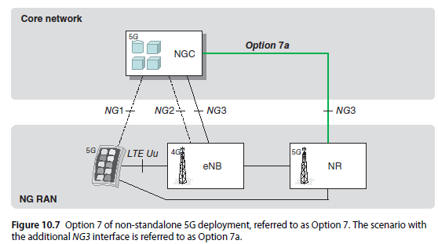
Non-Standalone 5G NR with 5G NGC

Slide 44
Non-Standalone 4G E-UTRA with 5G NGC
Yet another deployment scenario is based on dual connectivity with the 5G NR access node acting as the anchor component carrier for user and control planes. The evolved eNB has a role of secondary component carrier and transfers only user plane data. Signaling to the 5G NGC takes place via the NG1, NG2, and NG3 interfaces.
In this base-scenario referred to as Option 4, the user plane traffic goes from the evolved eNB radio access via the 5G NR access and ends at the 5G NGC.
This mode is called non-standalone because the evolved eNB user plane communications require access to the anchor point of the 5G NR. As is the case in previous options, this one has an alternative Option 4a, which means that the user plane traffic goes directly from the evolved eNB to the 5G NGC relying on the NG3 interface.
This scenario provides fluent deployment of 5G NR elements in locations where already existing 4G eNBs and 4G EPC infrastructure exists and can be upgraded or replaced with Evolved eNB elements and 5G NGC in such a way that the 5G NR access would be the dual connectivity anchor point instead of 4G.
One such case may be when the 5G NR can utilize lower-frequency bands than the evolved 4G eNB elements.

Slide 45
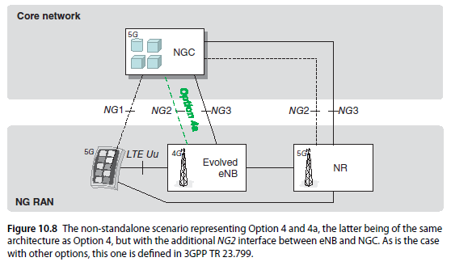
Non-Standalone 4G E-UTRA with 5G NGC

Slide 46
Deployment Scenarios of gNB/en-gNB
The 3GPP TS 38.401, Annex A, presents informative deployment scenario for the gNB and en-gNB. Based on this information, Figure 10.9 shows logical nodes (CU-C, CU-U, and DU), internal to a logical gNB/en-gNB. In this figure, the protocol terminations are indicated with circles.
The NG interface is defined in 3GPP TS 38.410, while the Xn interface is defined in 3GPP TS 38.420 and the F1 interface is defined in 3GPP TS 38.470.
Some key statements include:
gNB setup and configuration relying on operations and maintenance (O&A) system needs to be authenticated and authorized by gNB. This prevents external parties from modifying the gNB settings by using local or remote access methods. Furthermore, the communications between gNB and O&A must protect confidentiality, integrity, and relay.
gNB needs to support certificate mechanism detailed in 3GPP TS 33.310. Nevertheless, MNO decides the strategy for the utilization of the certificates.
More details of the security measures of gNB are summarized in ETSI 133 501, and the security associations between gNB, O&A, and 5G core network are detailed in 3GPP TS 33.210 and TS 33.310.

Slide 47
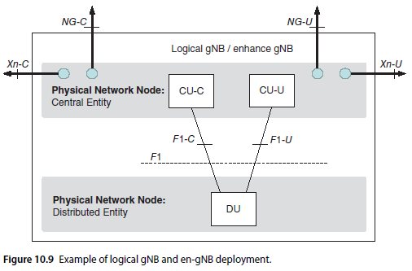
Deployment Scenarios of gNB/en-gNB

Slide 48
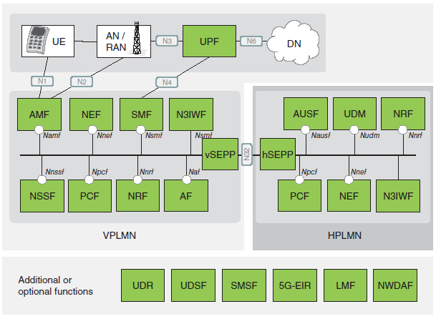
5G Network Interfaces and Elements
Interfaces

Slide 49
5G Core Network Elements
The 5G core network is based on cloud concept, and the most efficient forms of the core will take advance of network slicing and service-based architecture.
The deployment of these advanced features enhances the end-user’s perception of the QoS as the network develops.
the first step for practical core deployment is to take advantage of the already existing 4G infrastructure. This happens by using virtual 4G core, which is prepared for the transition, i.e. the already existing infrastructure can be prepared to provide a base for the “5G-ready” networks.
Then, relying on this base, it is possible to deploy new software functionalities such as network slicing, cloud-based VNF, SDN, and distributed user-plane and automatization. The existing network can be thus optimized and scaled up to support increasing 5G-type of use cases.

Slide 50
In 5G, the previous Long-Term Evolution (LTE) elements and their functions have been reorganized, and new network functions are introduced.
The service-based architecture reorganizes also the control plane so that instead of Mobility Management Entity (MME), S-GW and P-GW as they have defined in EPC, their functionality has been divided into AMF (Access and Mobility Management Function) and SMF (Session Management Function).

Slide 51
The 5G network function elements

Slide 52
The key elements of 5G
5G-EIR
The 5G Equipment Identity Register (5G-EIR) is an evolution of LTE EIR. As has been the principle in previous generations, it is also optional functionality in 5G network. The task of 5G-EIR is to check whether PEI (Permanent Equipment Identifier) has been blacklisted.
AF
The application function works in application layer of 5G, and it is comparable with the LTE access stratum (AS) and gsm Service Control Function (SCF). It interacts with the 3GPP core network to provide services such as application influence on traffic routing, access to Network Exposure Function (NEF), and interaction with the policy framework.
Depending on each deployment scenario, AF that the operator trusts may interact with relevant NFs while the Non-trusted AF rely on external exposure framework via NEF for the interaction with NF.

Slide 53
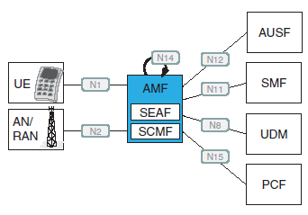
AMF (Access and Mobility Management Function)
The 5G AMF replaces the LTE MME.
The AMF performs termination of RAN Control Plane N2-interface and non-access stratum (NAS) N1-interface. It also manages NAS ciphering and integrity protection, registration, connection, reliability and mobility. It includes the Lawful Interception (LI) interface. Furthermore, it provides transport for SM messages between UE and SMF, and it functions as a transparent proxy for routing SM messages.
It does access authentication and authorization and provides transport for Short Message Service (SMS) messages between UE and Short Message Service Function (SMSF).

Slide 54
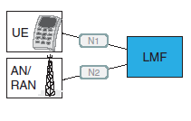
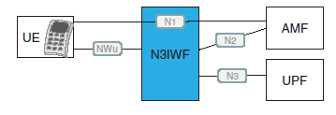
AUSF
The 5G Authentication Server Function (AUSF) replaces the LTE MME/AAA.
It has interfaces toward AMF and Unified Data Management (UDM)
LMF (Location Management Function)
The LMF can determinate the location for a UE.
N3IWF
The Non-3GPP Interworking Function (N3IWF) refers to the N3IWFs, which take place when untrusted access is used. In this case, the N3IWF establishes IPsec tunnel with the UE.
The N3IWF has termination points of N2 and N3 with the 5G core. It also relays uplink and downlink control-plane NAS signaling of N1 between the UE and AMF, and it handles N2 signaling from SMF and relayed by AMF related to PDU Sessions and QoS

Slide 55
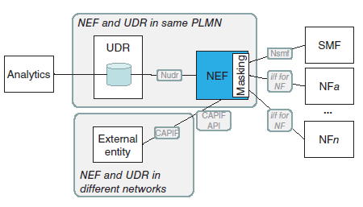
NEF
The 5G NEF is an evolution of Service Capability Exposure Function (SCEF) and application programming interface (API) layer of LTE. In 5G, it assists in storing and retrieving exposed capabilities and events of NFs via Nudr interface with unified data repository (UDR).
For the external exposure, NEF can communicate with the respective entities via Common API Framework (CAPIF) and respective API
One of the important tasks of NEF is to mask sensitive information to external AFs as per the MNO policy rules.

Slide 56
NEF
The NEF stores the available information retrieved from NFs into UDR in structured data format.
The PFDF is a repository that stores packet flow descriptions (PFDs).They can be added, updated and removed by the SCS/AS via the SCEF.
PFDF thus enables third-party AS to provide, modify, and remove PFDs via the SCEF into the MNO network. PFDF, in return, may store the PFDs or provision it to PCEF via JSON interface (Gw)
In 5G, the PFDF in the NEF may store and retrieve PFDs in the UDR. The NEF provides these PFDs to the SMF on pull request. The PFDs can also be delivered to SMF triggered by NEF push request.

Slide 57
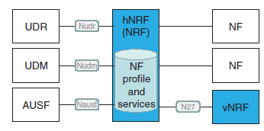
NRF
The 5G NF Repository Function is a part of the evolution of DNS utilized in LTE.
In 5G, it supports service discovery function for providing the information of the discovered NF instances to the requesting NF instance.
One of the tasks of the NRF is thus to maintain the NF profile and respective services of available NF instances.
NRF in the Visited PLMN is referred to as vNRF, and NRF in the Home PLMN is known as the hNRF, which is referenced by the vNRF via the N27 interface.

Slide 58

NSSF
The 5G Network Slice Selection Function is a new function to support the 5G-specific network slicing concept. The NSSF selects needed set of network slice instances serving the UE.
Furthermore, it determines the set of AMFs serving the UE, or alternatively, the list of candidate AMFs. For the latter task, the NSSF may make query to the NRF

Slide 59
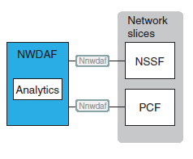
NWDAF
Network Data Analytics Function (NWDAF) refers to network analytics logical function, which 5G MNO manages. The task of the NWDAF is to provide slice-specific network data analytics to NFs, which are subscribed to it.
Please note that in the 3GPP Release 15, the only network functions defined to interface with the NWDAF via the standardized Nnwdaf are PCF for policy decision-making and NSSF for slice selection based on the load information.

Slide 60
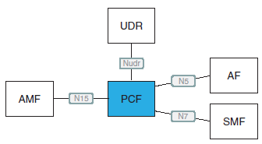
PCF
The 5G Policy Control Function is an evolution of the LTE PCRF (Policy and Charging Enforcement Function). In 5G, it supports unified policy framework to govern network behavior. It also provides policy rules to control plane functions to enforce them.

Slide 61
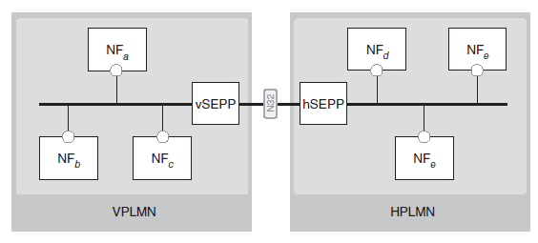
SEPP
The 5G Security Edge Protection Proxy (SEPP) is a new element for securely interconnecting 5G networks.
The visited network’s Security Edge Protection Proxy (vSEPP) refers to the SEPP functionality in visited PLMN while home Security Edge Protection Proxy (hSEPP) refers to the SEPP located at the home PLMN.
The SEPP provides end-to-end application-layer security for the signaling (e.g. security-sensitive IEs, i.e. information elements). The SEPP also takes care of the transport-layer security, referring to hop-by-hop security of adjacent nodes of the IPX network.

Slide 62
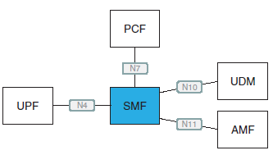
SMF
The 5G SMF replaces together with the 5G UDF the LTE S-GW and P-GW.
The SMF handles SM-related tasks so it can perform session establishment, modification and releasing. This includes the maintenance of tunnel in UPF–AN node interface.
The SMF also performs UE IP address allocation and management, and optionally related authorization.
Furthermore, SMF includes roaming functionality such as handling of local enforcement for QoS SLA of visited public land mobile network (VPLMN), collection and exposing of charging data (VPLMN), lawful intercept (VPLMN for SM events and interface to LI system), and interaction with external DN for signaling of PDU session authorization/authentication by external DN.

Slide 63
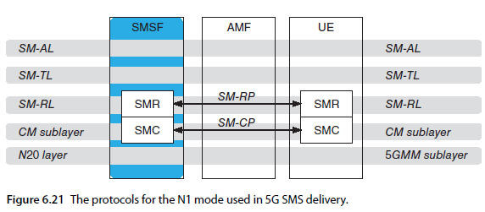
SMSF (Short Message Service Function)
The SMSF supports SMS over NAS in 5G infrastructure, managing SMS subscription data and its delivery. It includes SM-RP (Short Message Relay Protocol) and SM-CP (Short Message Control Protocol) with the UE.
It includes the procedures necessary to support the SMS between the mobile station (MS) and the mobile switching center (MSC), Serving GPRS Support Node (SGSN), MME, or SMSF.

Slide 64
UDM (Unified Data Management )
the UDM generates the 3GPP AKA Authentication Credentials per user. The UDM resides in the same Home Public Land Mobile Network (HPLMN) with the subscriber it serves. It performs user identification, including storage and management of SUPI per each individual 5G subscriber. Furthermore, it is capable of de-concealing the SUCI, which is the privacy-protected subscription identifier, i.e. the secret version of the SUPI.
The UDM also manages access authorizations such as roaming restriction.
The 5G UDM is an evolution of HSS and UDR utilized in LTE. It is for 5G data storing and retrieving.
As the 5G architecture is based on the separation of data and control planes, e.g. the network status information and other relevant data can be stored in a unified database.

Slide 65
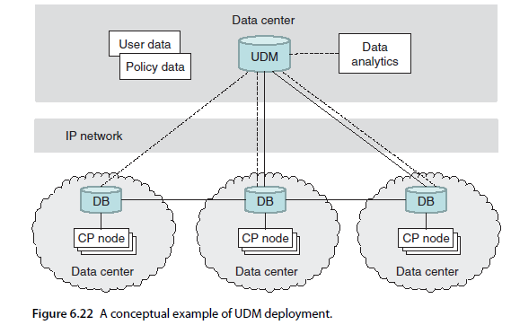
UDM

Slide 66
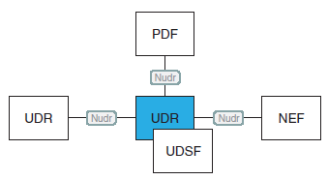
UDR (Unified Data Repository )
The 5G UDR is an evolution of the LTE SDS (Structured Data Storage).
the UDM can store and retrieve subscription data from and to UDR.
The UDR also takes care of storage and retrieval of policy data by the PCF, storage, and retrieval of structured data for exposure and application data by the NEF.

Slide 67
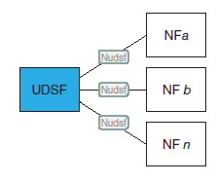
UDSF ( Unstructured Data Storage Function )
The 5G UDSF is a function comparable with LTE SDSF (Structured Data Storage Network Function).
In 5G, the UDSF is left as an optional function for storing and retrieval of information as unstructured data by any NF.

Slide 68
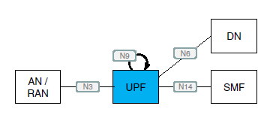
UPF (User Plane Function)
Along with the SMF, the 5G UPF replaces the LTE S-GW and P-GW. The UPF acts as an anchor point for intra- and inter-RAT mobility as appropriate. It also is the external PDU session point of interconnect to the data network and takes care of packet routing and forwarding.
It performs packet inspection and takes care of the user plane part of policy rule enforcement and LI. It performs traffic reporting and QoS handling for user plane, including data rate enforcement.
Data Network (DN), which represents the external network that a 5G User Equipment (UE) connects

Slide 69
Core Deployment
The NSA options specify only New Radio, which will work in tandem with 4G radio, relying completely on the 4G core. This scenario facilitates the 5G hotspots while the 4G provides the overlay network coverage. This option is known as E-UTRAN-NR dual connectivity (EN-DC).
5G Phase 1, by adding the specifications for the complete 5G radio (including standalone radio functionality), 5G core, the completely renewed security architecture and functionality, and respective supporting specifications.
The evolution of 5G includes the additions of new 5G functionalities in Release 16, also referred to as 5G Phase 2. It completes the 5G with the aim to comply with the ITU-R IMT-2020 requirements, including specifications for the mIoT (or, massive machine-type communication, mMTC) and ultra-reliable low-latency communications (URLLCs).

Slide 70
Initial Phase: Reusing Existing Infrastructure
Cost-efficient 5G deployment relies on the existing 4G infrastructure. The 3GPP specifications facilitate this gradual transition via multiple options summarized in previous sections. The interoperability and interworking between 4G and 5G is thus an elemental part of the 5G deployment scenarios.
The 5G radio network can be connected to 4G or 5G core. Furthermore, the 4G radio network can also be utilized as a part of the transition. The 5G network is referred tostandalone RAN when it consists solely of respective 5G base stations, gNB elements.
The non-standalone options refer to the combination of 4G and 5G base stations.
Option 3 is one of the most practical from the scenarios designed to facilitate the non-standalone deployments.
The EN-DC utilizes both LTE radio network and EPC core network of 4G.This means that the 5G-type of services will be available without replacing the network infrastructure.
In the EN-DC architecture, the LTE eNB infrastructure acts as a master RAN, and the 5G NR infrastructure can be added gradually in such a way that the UE is connected via dual connectivity to LTE and NR.

Slide 71
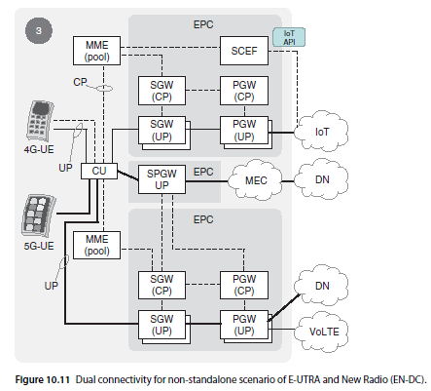

Slide 72
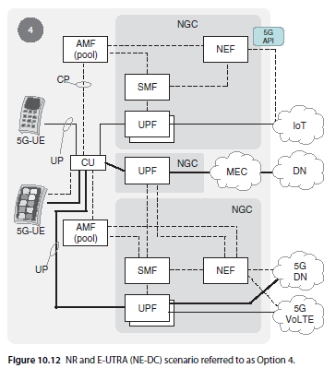
CoMP- option 4 mode
The idea of enhanced signaling for Inter-eNB CoMP is to provide a way to coordinate with the base station to minimize their interference.

Slide 73
Measurements
Network performance and functional measurements belong to the essential task set in the 5G network planning, deployment and optimization
There are commercial devices for testing and analysis of the measurement data.
The first-phase 5G networks are based on sub-6 GHz radio bands. They facilitate fast and fluent deployment and service coverage areas while the higher frequency bands provide with capacity extension via small cell deployments.
Measurement equipment must consider and support the new technical principles of 5G, such as network slicing and network functions virtualization.
The basics of the radio measurements remain the same as for the typical criteria for the results; some of the still useful measurements in 5G are related to the quality (bit rates, bit error rates), radio coverage areas (received power level), and capacity (including simultaneously communication devices).
Measurement Principles of 5G

Slide 74
Measurement Principles of 5G
Equipment must support wideband signal generators and signal analyzers, including mm-waves, to accommodate the new frequency ranges.
Higher frequencies (above 6 GHz) result in smaller coverage areas, often limited to small cell environments like a building floor or room.
For frequencies beyond 6 GHz, line of sight (LOS) is crucial, with obstructions like buildings and vegetation affecting coverage significantly.
The 60 GHz band experiences significant attenuation due to oxygen molecules, impacting radio wave propagation.
5G uses OFDM for both downlink and uplink, optimized with higher subcarrier spacing and modulation schemes like 256-QAM for high data rates.
Key metrics for evaluating modulation performance include peak-to-average power ratio (PAPR), out-of-band leakage (OOB), and bit error rate (BER).
5G networks support network slicing and virtualization, allowing for flexible performance levels and quality of service (QoS) adjustments.
Equipment must support multiuser environments, MIMO performance, low transmission latency, and precise synchronization to fully evaluate 5G network capabilities.

Slide 75
NGPaaS
Next Generation Platform-as-a-Service (NGPaaS) aim is to offer personalized and flexible platform for the further development of 5G, which also ensures better interoperability of the stakeholders.
Nokia Bell Labs is in a leading position to drive this development, which is a coalition of industry and academia and which is at the same time part of the 5G-PPP.
The PaaS concept is designed to bemore compatible with cloud ecosystems compared to the previous Infrastructure as a Service (IaaS) model . It is thus expected to be suitable for the needs of 5G related to the Virtual Network Function (VNF).
VNF, in turn, needs to support the demanding requirements of performance of 5G in terms of capacity, latency, and reliability.

Slide 76
THANK YOU

